Slide 1


User Mobility and Quality-of-Experience Aware
Placement of Virtual Network Functions in 5G
Final Defense Presentation
Supervised by
Dr. Mamun-or-Rashid, Professor
Dept of CSE, DU
Presented By
Palash Roy (Exam Roll-553)
Anika Tahsin (Exam Roll-567)
1

Slide 2
Overview
Introduction
Related Works
Proposed Approach
Performance Evaluation
Conclusion & Future Works

Slide 3
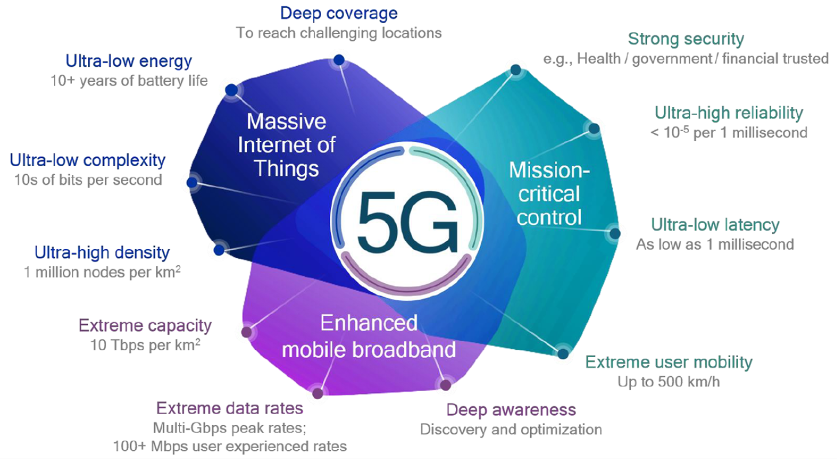
Introduction
5G
Fig: Features of 5G

Slide 4



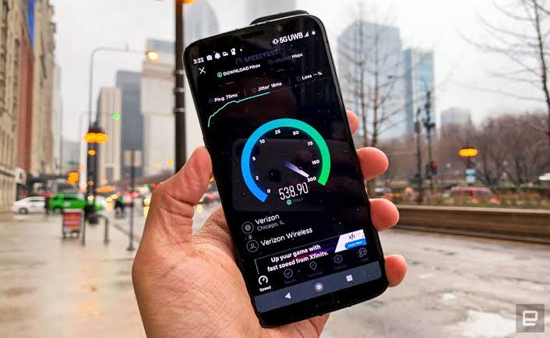
Revolutionary Applications of 5G
And many more!
Entertainment & Media
Smart City
Modern Agriculture
Broadband experience
4

Slide 5

Mobile Cloud Computing
Integrated with 5G
Uses Virtual Network Function (VNF)
Offers high computational power
Fig 1. Mobile Cloud Computing

Slide 6
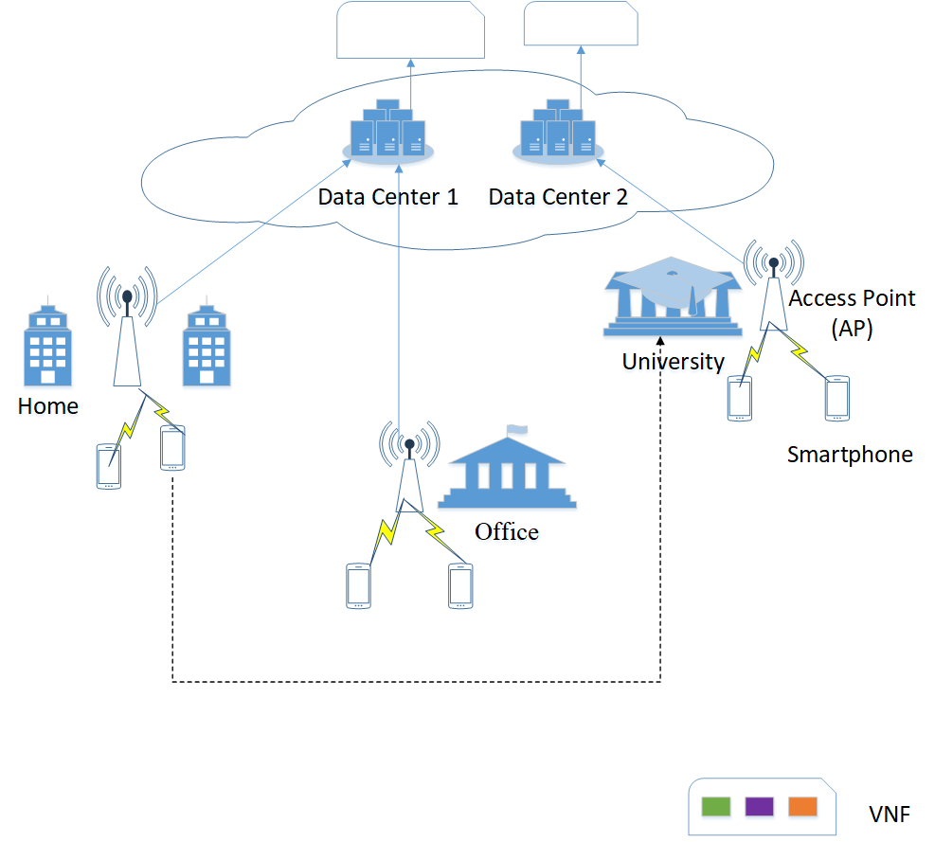

Problem Definition
Continue taking service from Data Center 1 through DC to DC communication
Relocating VNF to Data Center 2
Increased response time but
Reduced VNF relocation
Decreses response time
Two Conflicting Objectives!
Minimizing VNF relocation
Minimizing response time
Fig. 2: User Services Architecture in 5G
6

Slide 7
Objective & Contribution
Optimal placement of Virtual Network Functions (VNFs) in DCs
Maximizing QoE or decreasing the cost of operation
Trade-off between minimizing VNF relocation and response time
To study comprehensive performance of the proposed solution with the state-of-the-art works

Slide 8
Overview
Introduction
Related Works
Proposed Approach
Performance Evaluation
Conclusion & Future Works

Slide 9
Related Works
User mobility-aware virtual network function placement for virtual 5g network infrastructure [1]
Contribution:
Solution for minimizing VNF relocation
Solution for minimizing communication delay
Limitation:
Provide two individual solutions
Didn’t bring trade-off among them
9

Slide 10
Related Works
Dynamic resource allocation exploiting mobility prediction in mobile edge computing [2]
Contribution:
Proposed VM migration algorithm
Reducing total delay compared to other algorithms
Limitation:
Didn’t consider capacity of VM (Virtual Machines)
10

Slide 11
Overview
Introduction
Related Works
Proposed Approach
Performance Evaluation
Conclusion & Future Works

Slide 12
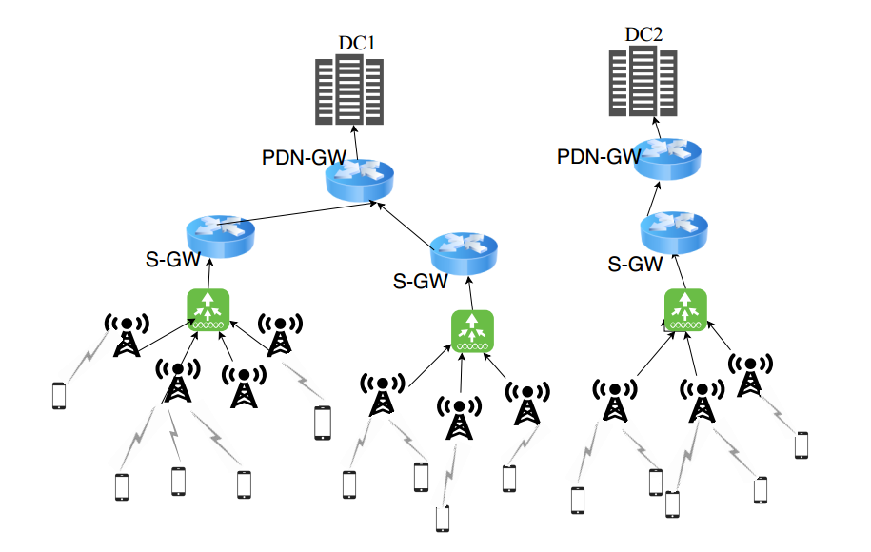
System Architecture
Fig 3: System Architecture of VNF services in 5G
12

Slide 13
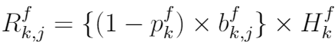
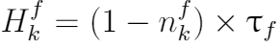
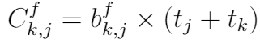
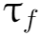
Optimal Placement of VNFs
For placing VNF f o V_{j} of eNB j N to DC k D:
Relocation time:
D = The set of data centers
N = The set of eNBs
V_{j} = The set of VNFs of eNB j N
b^{f}_{k, j} = Whether VNF f of eNB j N is
placed to DC k D or not.
p^{f}_{k} = Whether VNF f was previously
running on DC k D or not
n^{f}_{k} = Whether DC k D contains
VNF f or not
t_{j} = Communication time between
enB j and own DC
t_{k} = Communication time between
DC k and own DC
= Transfer time of VNF f
where,
Communication Time:
13

Slide 14
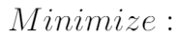
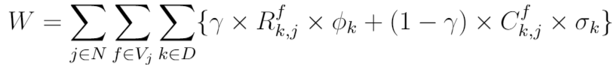
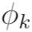
Optimal Placement of VNFs
Objective Function:
D = The set of data centers
N = The set of eNBs
V_{j} = The set of VNFs of eNB j N
γ = Priority Factor
= Cost to relocate a VNF to
DC k D
= Cost of taking service from
DC k D
Relocation Time
Communication Time
14

Slide 15
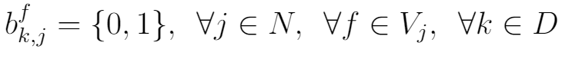
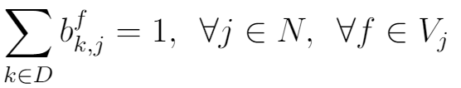
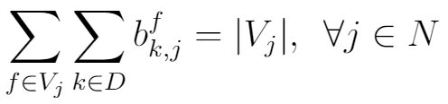
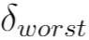
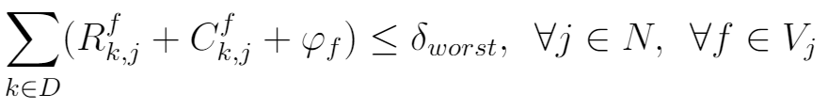
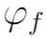
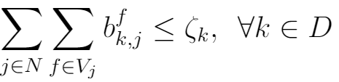
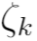
Optimal Placement of VNFs
Constraints:
D = The set of data centers
N = The set of eNBs
V_{j} = The set of VNFs of eNB j N
b^{f}_{k, j} = Whether VNF f of eNB j is placed
to DC k D or not.
= Maximum response time
tolerated by the application
= Execution time of VNF f V_{j}
= VNF holding capacity of DC k D
C1:
C2:
C3:
C4:
……
C5:
15

Slide 16
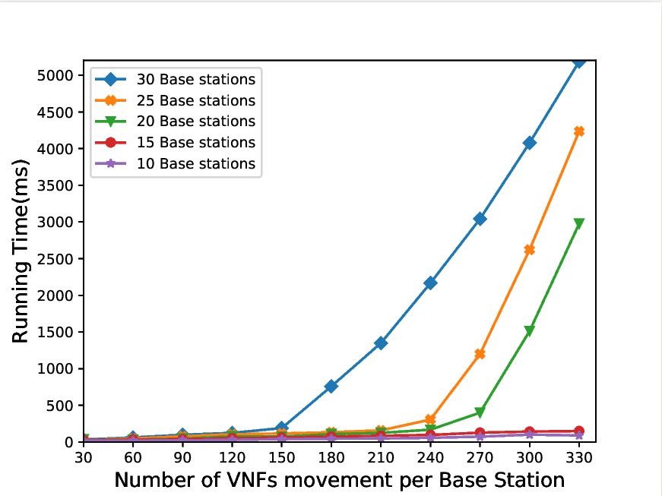
Computation Time for Optimal Placement of VNFs
Can be reduced to Generalized Assignment Problem (GAP)
NEOS Server
2 x Intel Xeon e5-2698 @2.3 GHz
92 GB RAM
NP-Hard
Fig. 4: Impacts of number of VNFs movement
per eNB on running time
13

Slide 17
a) Ant Colony Optimization (ACO)
Based VNF Allocation
b) Greedy Based First-Fit VNF
(FF-VNF) Allocation Problem
14

Slide 18
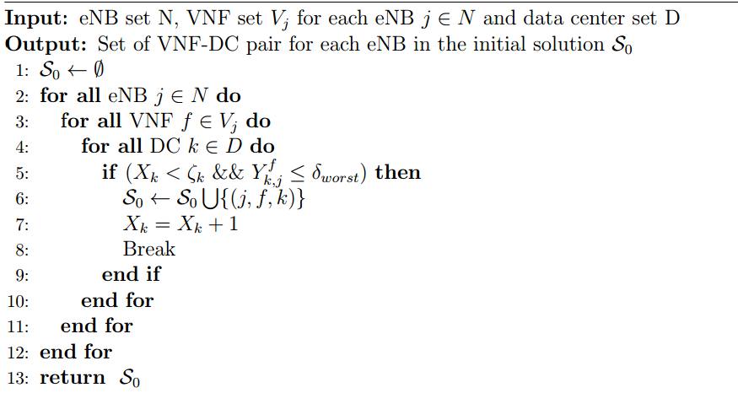
First-Fit (FF) Initial Solution
15

Slide 19
Ant Colony Optimization (ACO)
Based VNF Allocation
Initial Pheromone Calculation
Local Heuristic Calculation
DC selection
Update Local Pheromone
Update Global Pheromone
16

Slide 20
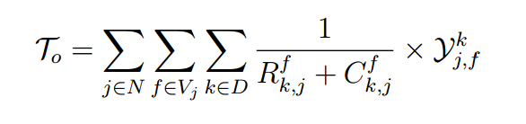
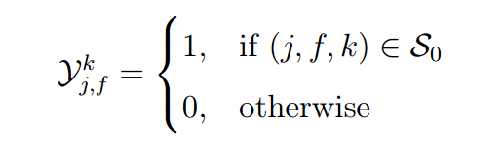
ACO based VNF Allocation (1/3)
Initial Pheromone Calculation
………………… (3.20)
Performance Evaluation
…………………....(3.21)
17

Slide 21
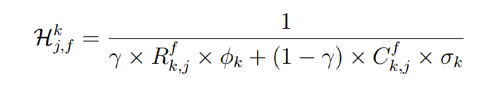
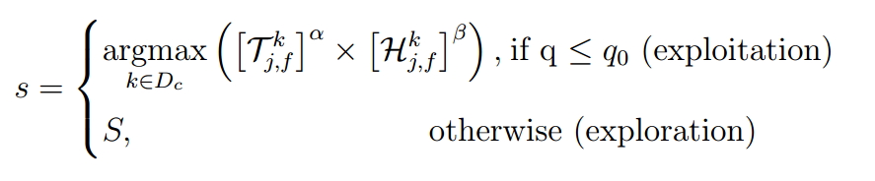
ACO based VNF Allocation (2/3)
Local Heuristic Calculation
……… (3.22)
Selection of Data Center
……… (3.23)
18

Slide 22
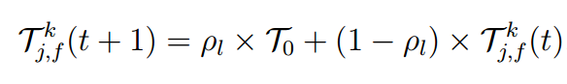
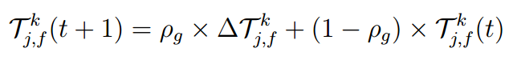
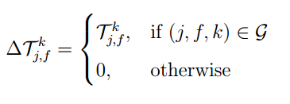
ACO based VNF Allocation (3/3)
Local Pheromone Update
………….. (3.25)
Global Pheromone Update
…. (3.26)
19

Slide 23
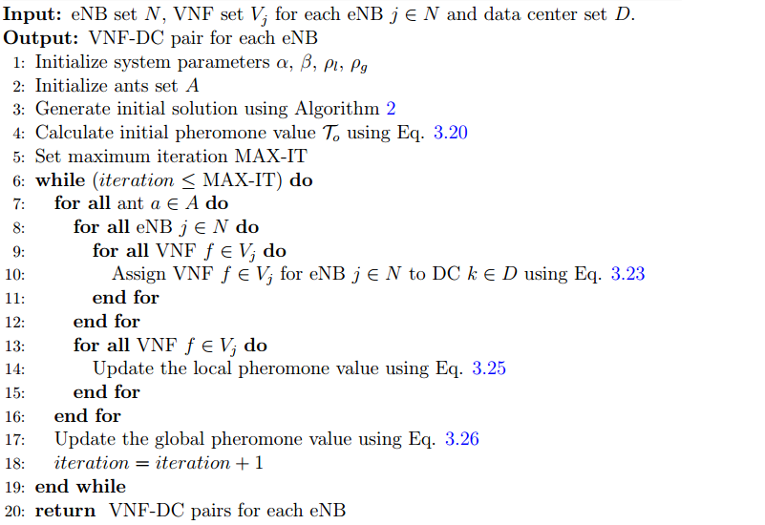
Ant Colony Optimization based VNF Allocation
20

Slide 24
Overview
Introduction
Related Works
Proposed Approach
Performance Evaluation
Conclusion & Future Works

Slide 25
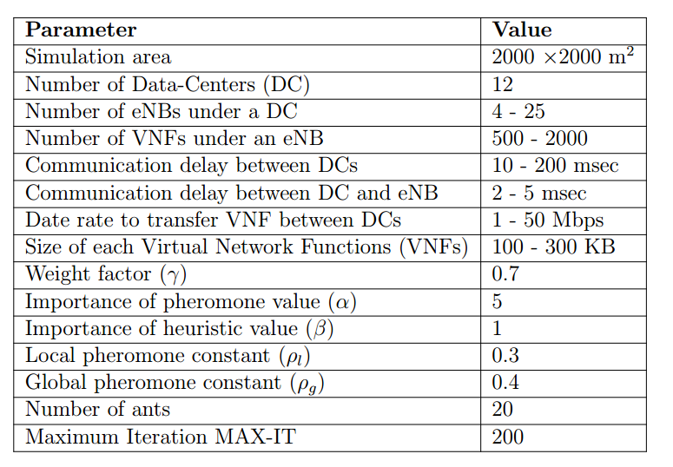
Simulation Environment
CloudSim Environment
22

Slide 26
Performance Metrics
Quality-of-Experience (QoE)
Number of relocations of the VNFs
User Satisfaction
VNF Relocation Overhead
23

Slide 27
Simulation Result
Impact of varying number of VNFs movement
Impact of varying number of eNB per DC
Impact of varying number of VNF holding capacity of DC
Number of Data Centers: 12
Number of eNB per DC: 20
VNFs holding capacity of DC: 600
23

Slide 28
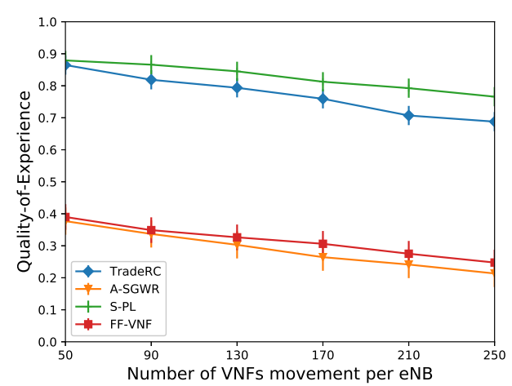
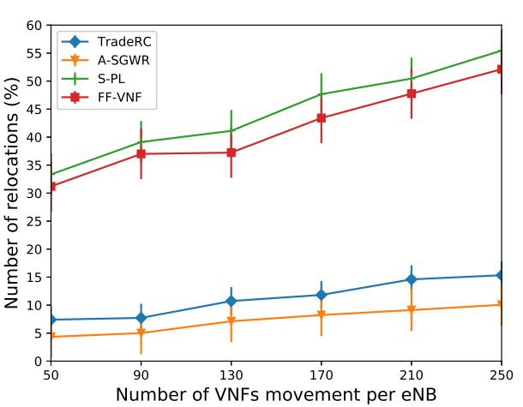
Impact of varying number of VNFs movement(1/2)
(a)
(b)
Fig 5: Impacts of varying number of VNFs movement on (a) QoE (b) Number of relocations
24

Slide 29
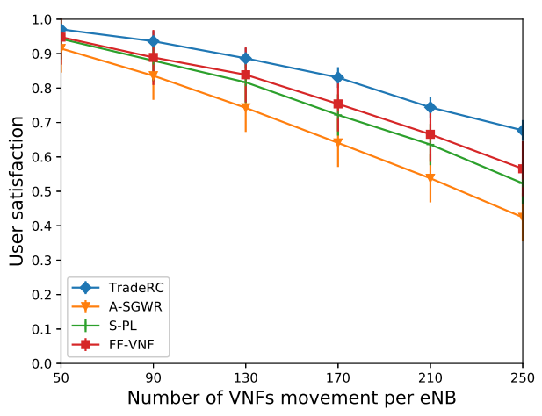
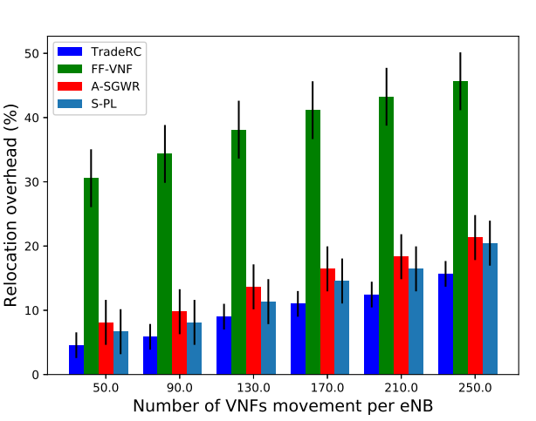
Impact of varying number of VNFs movement(2/2)
(c) (d)
Fig 6: Impacts of varying number of VNFs movement on (a) User Satisfaction (b) Relocation Overhead
25

Slide 30
Simulation Result
Impact of varying number of VNFs movement
Impact of varying number of eNB per DC
Impact of varying number of VNF holding capacity of DC
Number of Data Centers: 12
Number of VNFs movement per eNB: 250
VNFs holding capacity of DC: 600
23

Slide 31
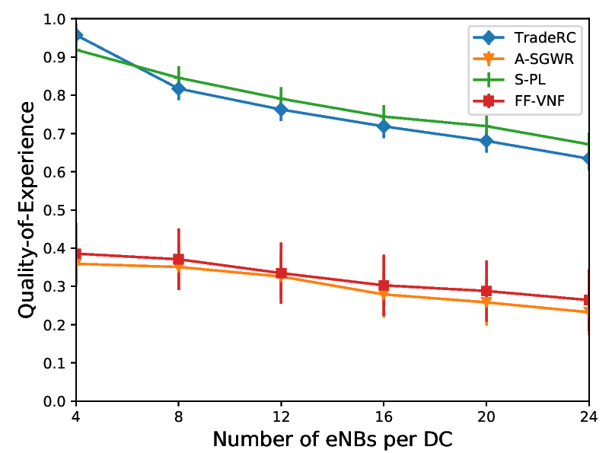
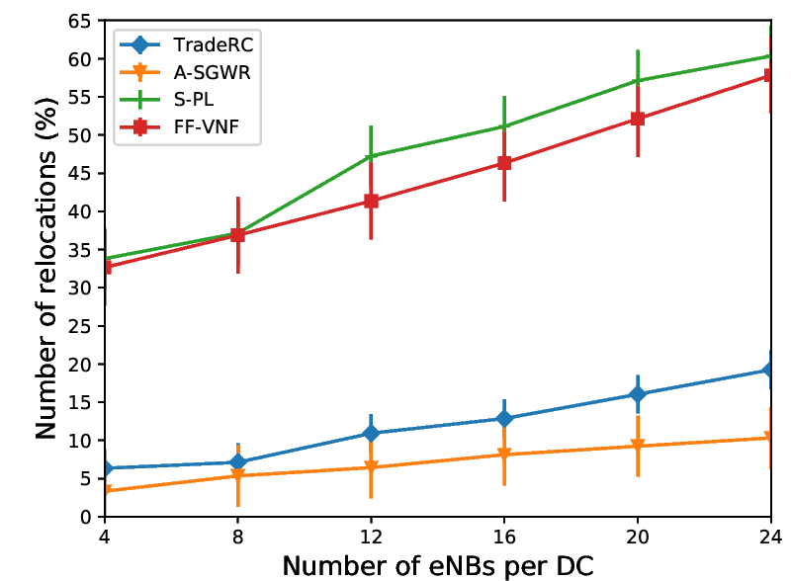
Impact of varying number of eNBs per DC(1/2)
(a) (b)
Fig 7: Impacts of varying number of BS per DC on (a) QoE (b) Number of relocations
25

Slide 32
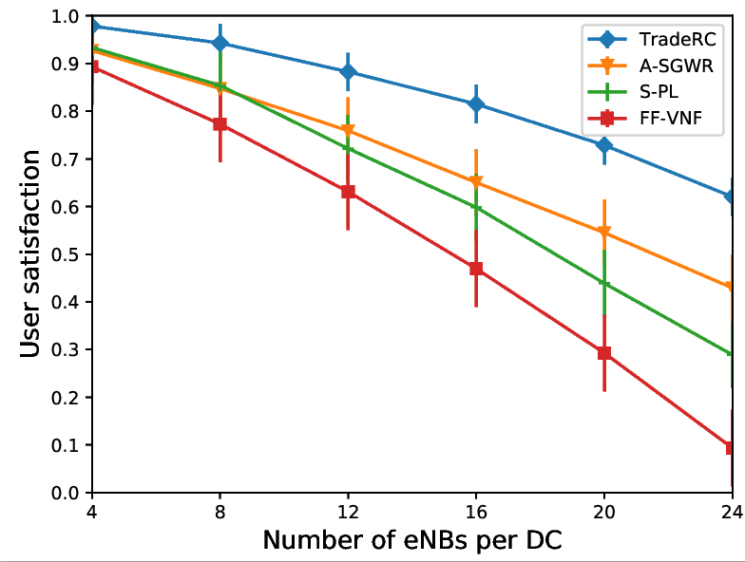
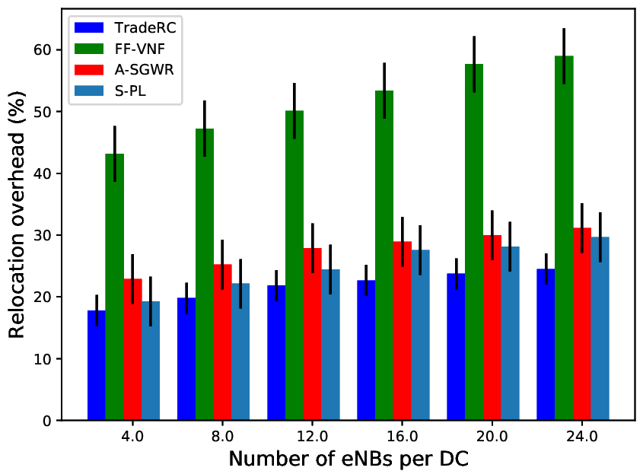
Impact of varying number of eNBs per DC(2/2)
(c) (d)
Fig 8: Impacts of varying number of BS per DC on (a) User Satisfaction (b) Relocation Overhead
25

Slide 33
Simulation Result
Impact of varying number of VNFs movement
Impact of varying number of eNB per DC
Impact of varying number of VNF holding capacity of DC
Number of Data Centers: 12
Number of eNB per DC: 20
Number of VNFs movement per eNB: 250
23

Slide 34
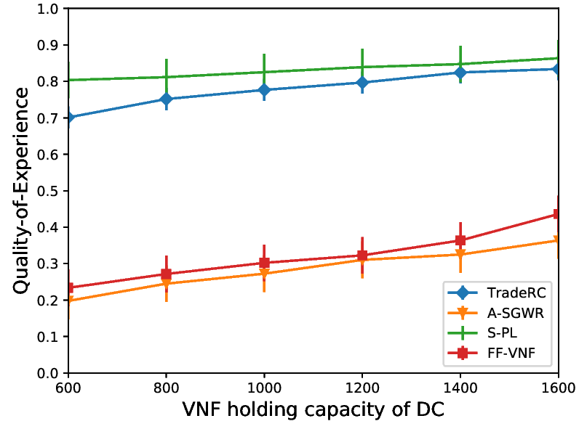
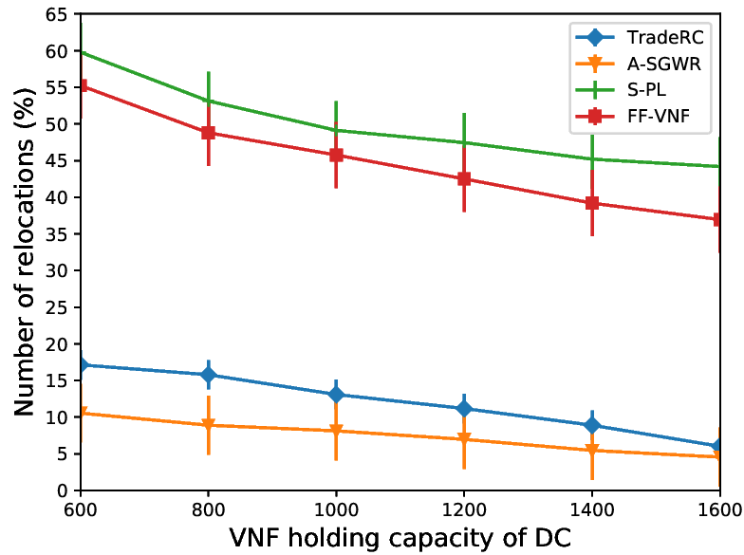
Impact of varying number of VNF holding capacity of DC(1/2)
(a) (b)
Fig 9: Impacts of of VNF holding capacity of DC on (a) QoE (b) Number of Relocations
25

Slide 35
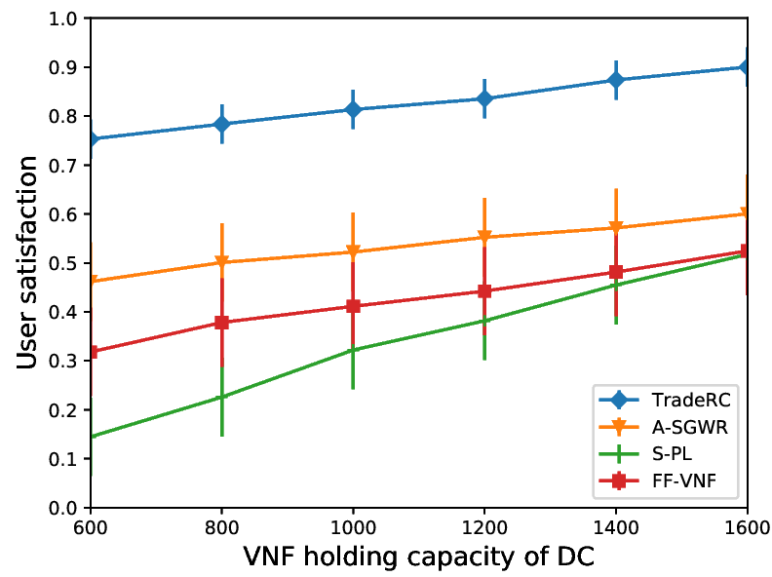
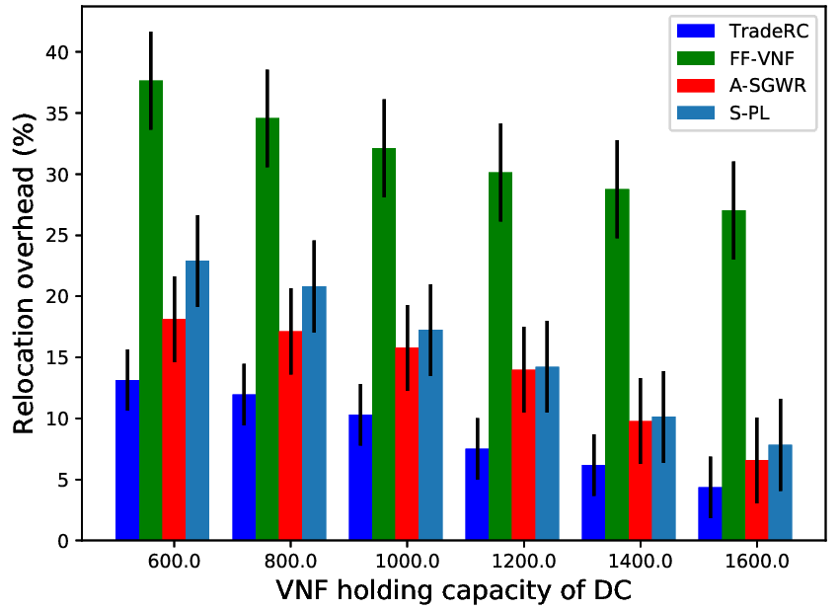
Impact of varying number of VNF holding capacity of DC(2/2)
(c) (d)
Fig 10: Impacts of VNF holding capacity of DC on (a) User Satisfaction (b) Relocation Overhead
25

Slide 36
Overview
Introduction
Related Works
Proposed Approach
Performance Evaluation
Conclusion & Future Works

Slide 37
Conclusion
Optimal Placement of VNF
Trading off between VNF relocation and QoE
NP-hard problem
Ant Colony Optimization (ACO) based VNF placement
Maximizes user satisfaction (as high as 25%)
Minimizes VNF relocations overhead (as high as 15%)
37

Slide 38
Future Research Scope
Mathematical modeling & analysis
Load balance among the DCs
38

Slide 39
References
T. Taleb, M. Bagaa, and A. Ksentini, “User mobility-aware virtual network function placement for virtual 5g network infrastructure,” in 2015 IEEE International Conference on Communications (ICC), June 2015, pp. 3879–3884.
J. Plachy, Z. Becvar, and E. C. Strinati, “Dynamic resource allocation exploiting mobility prediction in mobile edge computing,” in 2016 IEEE 27th Annual International Symposium on Personal, Indoor, and Mobile Radio Communications (PIMRC), Sep. 2016, pp. 1–6.
A. Enayet, M. A. Razzaque, M. M. Hassan, A. Alamri, and G. Fortino, “A mobility-aware optimal resource allocation architecture for big data task execution on mobile cloud in smart cities,” IEEE Communications Magazine, vol. 56, no. 2, pp. 110–117, Feb 2018
N. M. Akshatha, P. Jha, and A. Karandikar, “A centralized sdn architecture for the 5g cellular network,” in 2018 IEEE 5G World Forum (5GWF), July 2018, pp. 147–152
Min Chen, Yixue Hao, Hamid Gharavi, and Victor C.M. Leung. Cognitive information measurements: A new perspective. Information Sciences, 505:487 - 497, 2019
M. Chen, Y. Hao, L. Hu, K. Huang, and V. K. N. Lau. Green and mobility aware caching in 5g networks. IEEE Transactions on Wireless Communications, 16(12):8347{8361, Dec 2017
39

Slide 40
List of Publications
Palash Roy, Anika Tahsin, Sujan Sarker, Tamal Adhikary, Md. Abdur Razzaque, Mohammad Mehedi Hassan, “User mobility and Quality-of-Experience aware placement of Virtual Network Functions in 5G", Elsevier Computer Communications Journal 2019, vol. 150, pages. 367 - 377, January 2020. doi: https://doi.org/10.1016/j.comcom.2019.12.005.
40

Slide 41


Any Question ?

Slide 42
Thank You

Slide 43
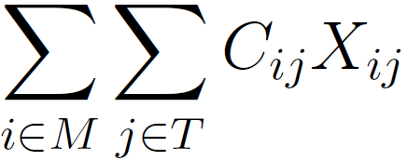
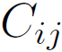
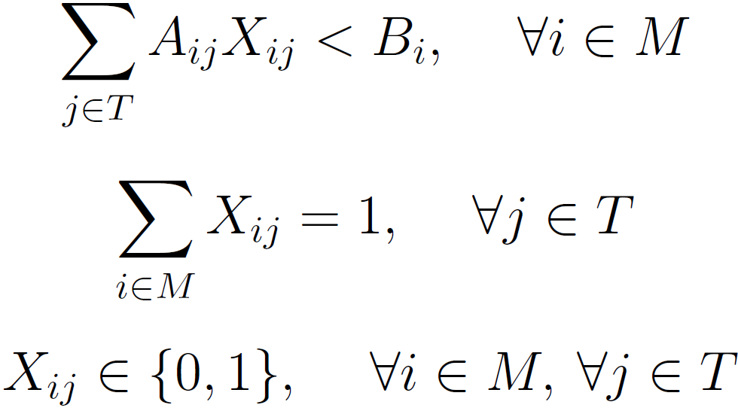
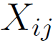
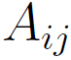
Proof of NP-Hardness
Generalized Assignment Problem (GAP):
Minimize:
T = Set of tasks
M = Set of agents
= Cost of assigning task j to
agent i
= Capacity of agent i used to
assign task j
= Whether task j is assigned
to agent i
Subject to,
13

Slide 44
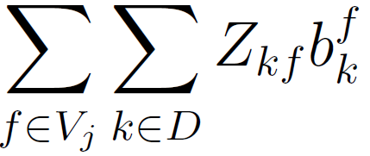
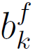
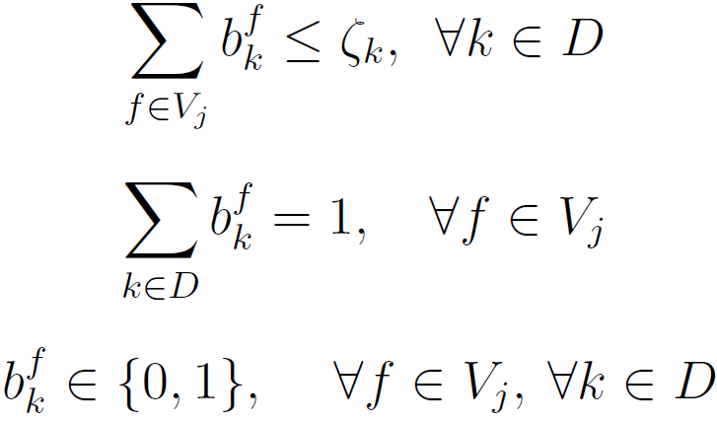

Proof of NP-Hardness
Optimal VNF Placement Problem Reduced to GAP:
Minimize:
D = The set of data centers
V_{j} = The set of VNFs of eNB j
= Whether VNF f is placed to
DC k or not
Subject to,
13

